Slide 1
AlphaZero for Connect 4
Ishtdeep Singh, Wei Ren Gan, Aayush Chudgar

Slide 2
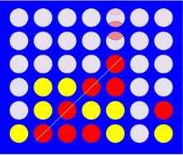
Introduction
AlphaZero is a self – play RL algorithm which combines MCTS with policy learning.
Connect 4 is a game in which the objective is to make have a straight line with 4 of the player’s tokens.
The game is complex current actions affect future.
No immediate rewards.

Slide 3
Our implementation of AlphaZero
Neural network represents the policy and the value function.
For each move, the algorithm runs a set of MCTS simulations till the end using the current policy.
Uses the UCB algorithm to pick moves during the search.
After search is finished, there is a prob distribution across all the available moves.
The move to be played is chosen from this distribution

Slide 4
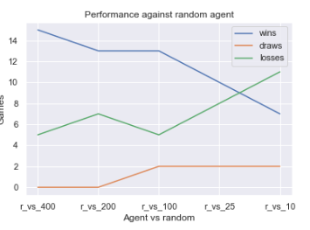
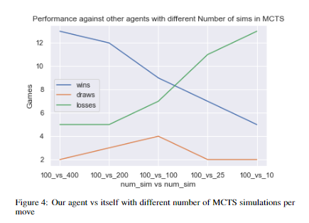
Results

Slide 5
Future work
To run the algorithm for more than 100,000 episodes.
To make a parallel version of the algorithm so that we can increase the speed of training
To tune the hyperparameters.

Slide 6
Thank you

